Slide 1
UNIT 1: Machine Learning Foundation (Lecture 2)

Slide 2
Quiz Time:
Which of the following is a type of Machine Learning where the model is trained on labeled data? A) Supervised Learning B) Unsupervised Learning C) Reinforcement Learning D) Deep Learning

Slide 3
Quiz Time:
Which type of Machine Learning is used when an agent learns by interacting with the environment to maximize a reward? A) Supervised Learning B) Unsupervised Learning C) Reinforcement Learning D) Semi-Supervised Learning

Slide 4
Quiz Time:
Robot navigation where the robot improves performance through trial and error belongs to which type? A) Supervised Learning B) Unsupervised Learning C) Reinforcement Learning D) Semi-Supervised Learning

Slide 5
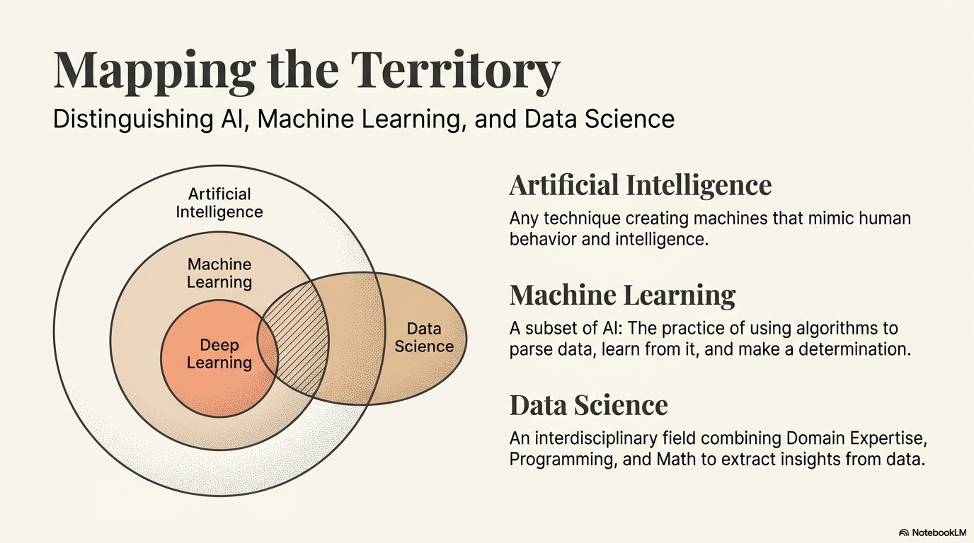
AI vs ML vs Data Science

Slide 6
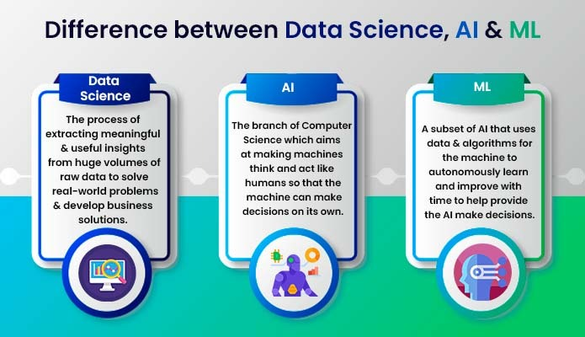

Slide 7
The story of a Smart Hospital
AI vs ML vs Data Science
Imagine you are building a futuristic “Smart Hospital”.
The AI Vision
The ML Engine
The Data Science Insights
You want a robotic assistant that can walk through halls, talk to patients, and decide which emergency needs attention first.
To make this robot useful, it needs to recognize diseases in X-rays.
Meanwhile, the hospital administrator asks, "Why are patients waiting so long on Tuesdays?"
You don't program "if pixel is red, it's a tumor".
Instead, you feed it 50,000 X-rays so it can learn the patterns of a tumor on its own.
You dive into the logs, clean up the messy data, create visualizations, and discover that a specific lab is understaffed during lunch hours. You've just extracted a "business insight" from data.
This robot is mimicking human-like behavior and reasoning.

Slide 8
AI vs ML vs Data Science
While these fields overlap significantly, their core objectives and methodologies differ. Here is a breakdown…
Feature | Artificial Intelligence (AI) | Machine Learning (ML) | Data Science (DS)
Core Definition | Systems that mimic human intelligence to perform tasks. | A subset of AI that learns patterns from data without explicit programming. | An interdisciplinary field used to extract insights and "meaning" from data.
Primary Goal | To create "smart" machines that can reason and act. | To build models that improve their performance as they see more data. | To find hidden patterns and actionable insights to solve problems.
Data Type | Often uses rules and logic; doesn't always need "big data". | Highly dependent on large, high-quality structured/unstructured data. | Handles the entire data pipeline (cleaning, processing, and analyzing).
Key Tools | Logic engines, Neural Networks, Robotics. | NumPy, Scikit-Learn, TensorFlow, PyTorch. | Pandas, Matplotlib, SQL, Tableau.
Real-World Example | A humanoid robot or a self-driving car's decision-making system. | A Netflix "Recommended for You" list or a Spam Filter. | Analyzing 5 years of sales data to predict next year's budget.

Slide 9
Key Takeaways!
AI vs ML vs Data Science
AI is the "What":
ML is the "How":
Data Science is the "Why":
The goal of making a machine "smart".
The mathematical engine that allows the machine to learn.
The holistic process of using data (including ML) to answer specific questions.

Slide 10
MCQ:
Where can we apply supervised learning?
Analyzing spam emails
Image recognition
Sentiment analysis
All of the above

Slide 11
MCQ:
Where can we apply supervised learning?
Analyzing spam emails
Image recognition
Sentiment analysis
All of the above

Slide 12
Parametric models:
Parametric models summarize data using a fixed number of parameters, regardless of the size of the dataset. They make strong assumptions about the underlying data distribution.
Characteristics:
Have a fixed structure.
Require estimating a finite number of parameters.
Often assume a specific form of the function (like linear, Gaussian, etc.).
Typically require less data to train.
Easier and faster to compute.

Slide 13
Examples:
Linear regression (parameters: slope m and intercept b)
Logistic regression
Normal distribution (mean μ and standard deviation σ)
Naive Bayes

Slide 14
Parametric Model Scenario: A real-estate firm predicts house prices using area, number of rooms, and location score.
Model Used: Linear Regression (Parametric)
Why Parametric?
Relationship is approximately LINEAR
Limited, well-defined features
Easy to interpret coefficients
Real-time Use: Property valuation tools, bank loan approvals

Slide 15
Pros:
Simple and interpretable.
Computationally efficient.
Good when model assumptions are correct.
Cons:
May perform poorly if the model assumptions are wrong.
Not flexible enough for complex relationships.

Slide 16
Non-Parametric Models:
Non-parametric models do not assume a specific functional form for the relationship between input and output. The number of parameters can grow with the size of the data.
Characteristics:
Flexible and can capture complex patterns.
Often need more data to perform well.
Can adapt their complexity to the data.
Typically, slower to compute, especially on large datasets.

Slide 17
Examples:
K-Nearest Neighbors (KNN)
Decision trees / Random forests
Kernel density estimation

Slide 18
Non-Parametric Model Scenario:
Problem: A housing portal uses 20+ features including neighborhood trends, crime rate, school ratings, and buyer behavior.
Model Used: Decision Tree / Random Forest
Why Non-Parametric?
Complex, NON-LINEAR interactions
No fixed equation assumed
Real-time Use: Online real-estate recommendation platforms

Slide 19
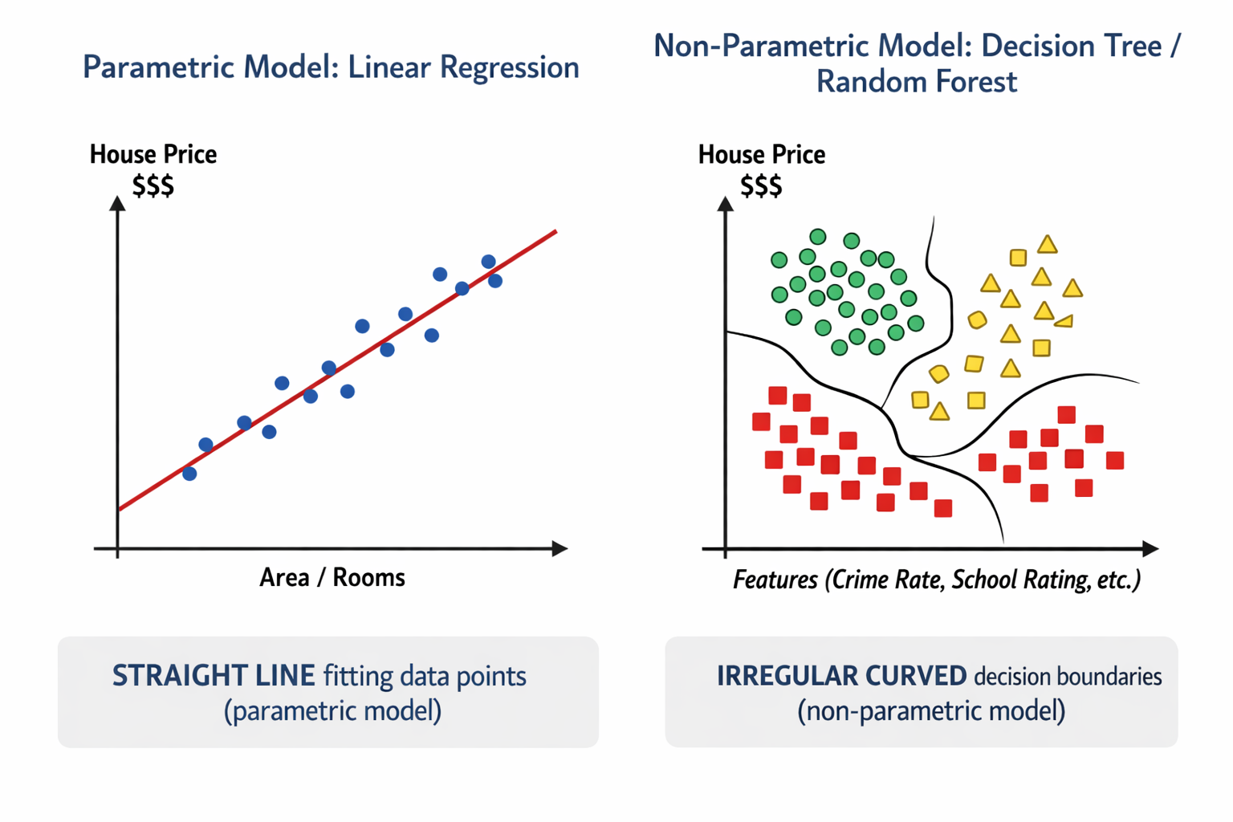

Slide 20
Pros:
Very flexible, can model non-linear relationships.
Fewer assumptions about the underlying distribution.
Cons:
Require large datasets to avoid overfitting.
Often less interpretable.
Computationally more expensive.

Slide 21
Feature | Parametric | Non-Parametric
Number of Parameters | Fixed | Grows with data
Assumptions about Data | Strong (e.g., linearity) | Few or none
Flexibility | Limited | High
Data Requirement | Less | More
Computation | Fast | Slower
Example Models | Linear/Logistic regression | KNN, Decision Trees, SVM (with kernel)

Slide 22
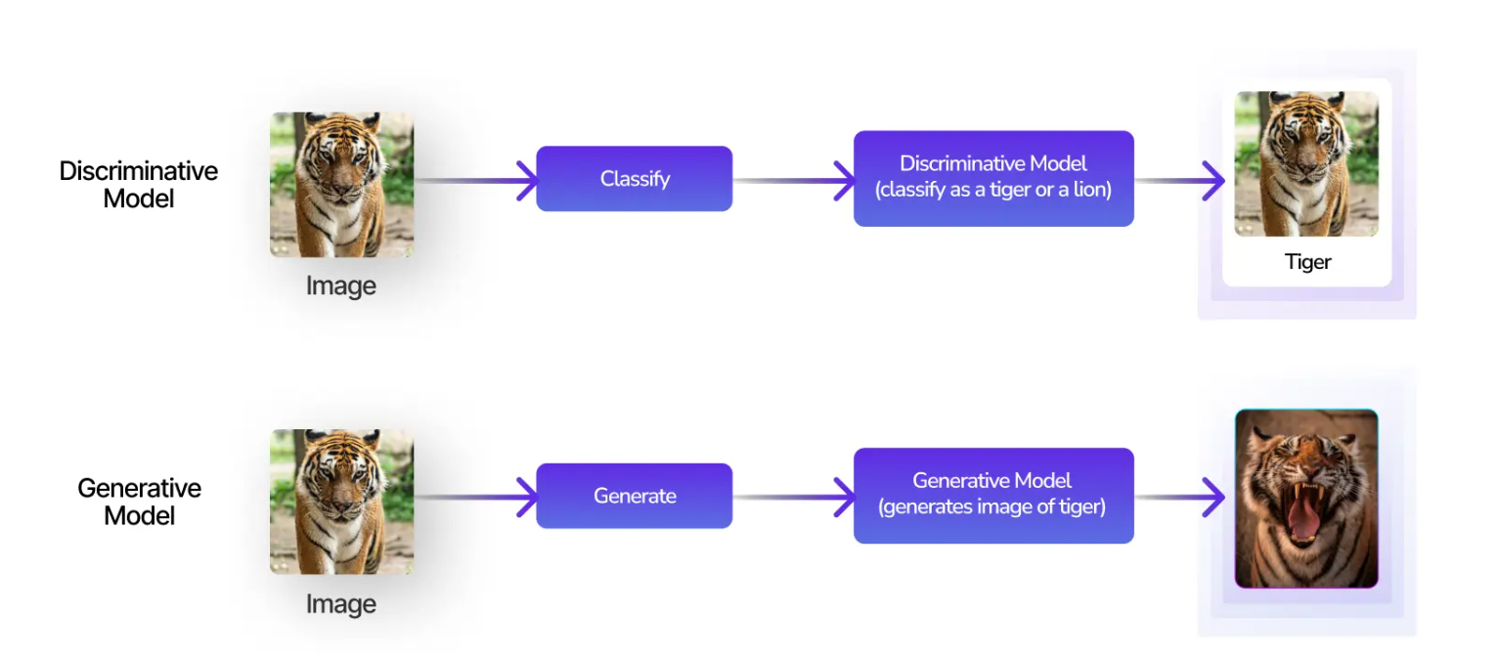
Generative vs Discriminative Models:

Slide 23
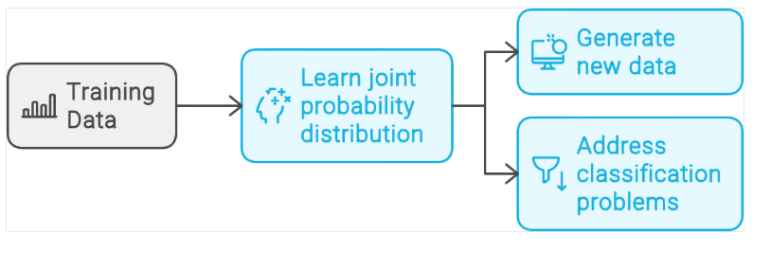
What Are Generative Models?
Given a set of example data points, D, and their associated labels, L, a generative model learns the joint probability distribution P(D, L).
It then uses this underlying distribution to generate new data similar to the training examples or address classification problems.

Slide 24
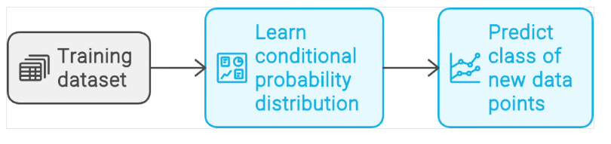
What Are Discriminative Models?
Given a training dataset consisting of data points, D, and their associated labels, L, a discriminative model learns the conditional probability distribution P(D | L).
It then uses this conditional probability distribution to predict the class of new data points.

Slide 25
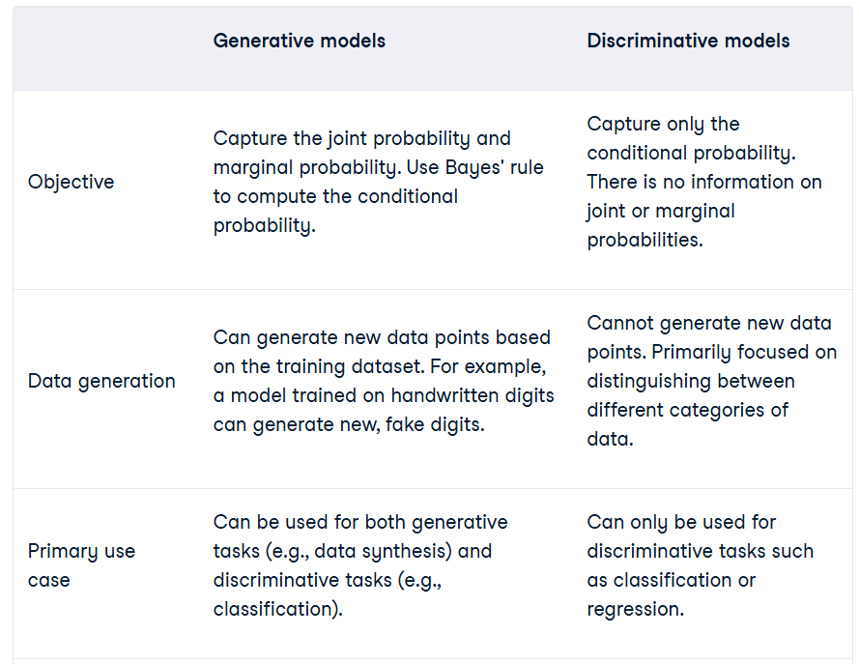

Slide 26
Aspect | Generative Models | Discriminative Models
What they learn | How data is generated | How to separate classes
Probability modeled | P(X, Y) or P(X | Y) | P(Y | X)
Main focus | Data distribution | Decision boundary
Can generate data? | YES | NO
Handles missing data | Better | Poorer
Data requirement | Works with smaller datasets | Needs larger datasets
Accuracy | Usually lower | Usually higher
Interpretability | Probabilistic | Boundary-based
Training speed | Faster | Slower
Use case strength | Understanding data | Classification accuracy

